Slide 1
Hackathon Topic: Ecommerce Product Categorization
Problem Statement: In the rapidly evolving world of eCommerce, accurate product categorization is crucial for ensuring seamless customer experiences, reducing search friction, and increasing product discoverability. However, the sheer volume of diverse products poses a significant challenge. Current classification systems struggle to handle ambiguities, unconventional naming conventions, and multi-language data. This hackathon aims to address these challenges by inviting participants to create innovative solutions that enhance product categorization efficiency, accuracy, and scalability.
Solution: Develop a text classification model that categorizes products with maximum accuracy based on description of the product.
CK
by Chetan Kittali

Slide 2
Problem Solving Approach
Load the dataset
Perform Exploratory Data Analysis to extract valuable business insights
Using NLTK for Data preprocessing and Feature Engineering.
Transform Textual Descriptions to numerical features using techniques like TF-IDF or word2Vec.
Perform train-test split using stratify sampling
Train and evaluate various suitable Machine Learning and Deep Learning models if needed.
Fine tune them if necessary, using Hyperparameter Tuning
Get our predictions.
Finally, we will compare the models to get the best performing model.

Slide 3
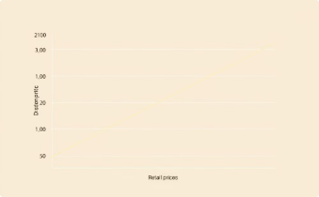
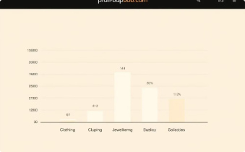
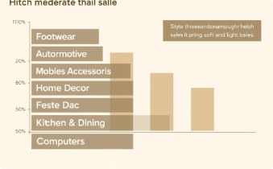
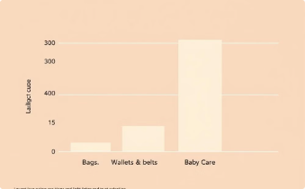
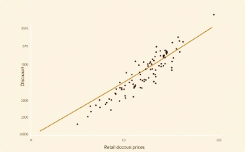
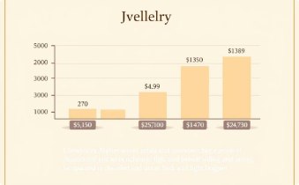
Key Insights
Price Correlation
Top Sellers
Moderate Sales
Low Sellers
Higher retail prices correspond to higher discount prices.
Clothing and Jewellery are the highest selling product categories.
Moderate sales in various categories.
Bags, Wallets & Belts, and Baby Care show the lowest sales.
Retail vs Discount
Jewellery Pricing
Higher retail price means higher discount price.
Jewellery has the highest average retail and discounted price.

Slide 4
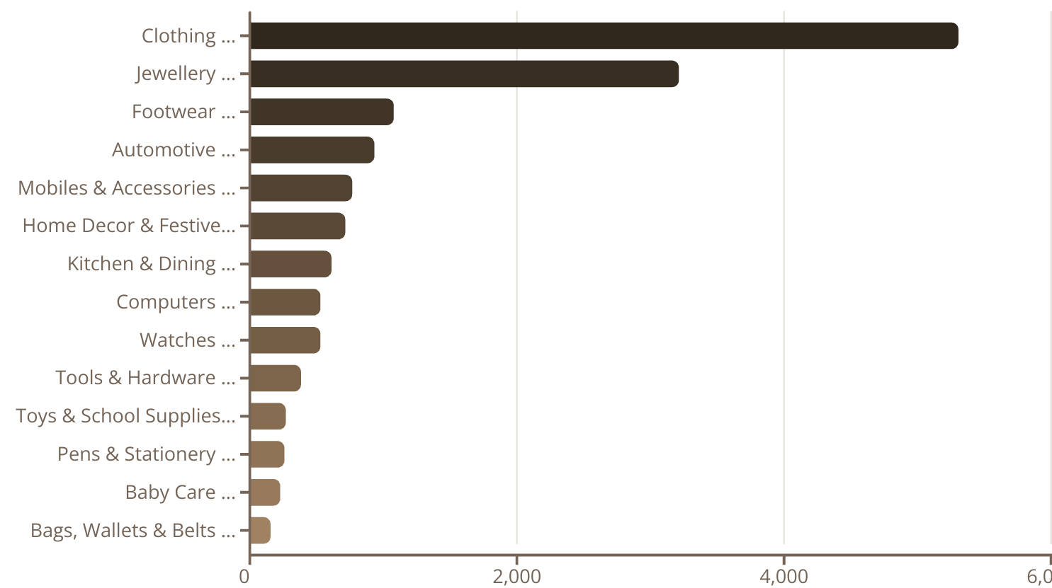
Frequency counts of Product Category Tree

Slide 5
CHALLENGES
Problem: Class Imbalance
Solution: Employing techniques like stratified sampling and SMOTE oversampling to balance the dataset and improve model accuracy.
Problem: Natural Text Preprocessing and Converting to numeric data
Solution: Using NLTK and techniques like TF-IDF or word2Vec for preprocessing and feature extraction

Slide 6
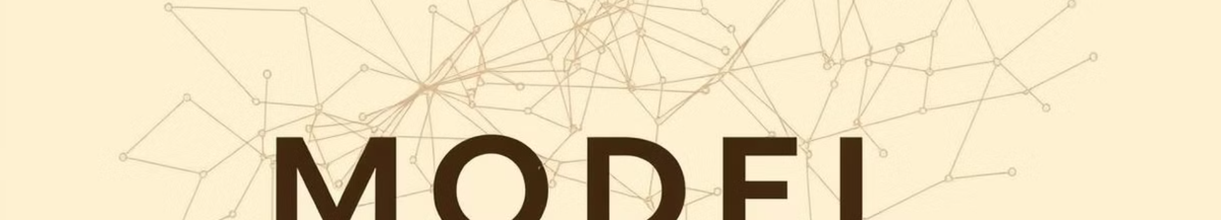
Model Selection and Training
Models
Train Accuracy
Test Accuracy
SVM
99.78%
98.19
Logistic Regression
99.52%
98.04
Random Forest
99.90%
97.85
Decision Tree
99.90%
96.29
KNN Classifier
99.50%
95.11

Slide 7
Evaluation and Final Results
MODEL: Support Vector Machine (SVC) has achieved the highest accuracy among other.
98%
Accuracy
Our model achieved an impressive accuracy of 98% on a diverse dataset of product descriptions after fine tuning

Slide 8




Benefits of Accurate Categorization
Improved Customer Experience
Seamless browsing and navigation, making it easier for customers to find the products they're looking for.
Increased Product Discoverability
Customers are exposed to a wider range of relevant products, leading to increased sales and customer satisfaction.
Reduced Search Friction
Customers can quickly find the products they want, reducing frustration and abandoned searches.

Slide 9

Conclusion and Next Steps
The development of accurate product categorization models is essential for the success of eCommerce platforms. Future research may explore the use of advanced deep learning models and the integration of visual features, such as product images.

